Slide 1
SmartPizza
Full Stack Microservices Pizza Ordering and Delivery System

Slide 2
Problem Statement
Fragmented ordering and delivery experience
Limited visibility for customer delivery tracking
Need for analytics-driven administration

Slide 3
Objectives
Secure role-based login
Customer ordering and payment flow
Delivery agent assignment and tracking
Admin analytics dashboard

Slide 4
User Roles
Customer: browse, cart, checkout, payment, tracking
Delivery Agent: accept delivery, map, mark delivered
Admin: analytics, users, orders

Slide 5
Architecture
React frontend
API Gateway
Eureka discovery
Auth, Order, Delivery, Admin services
MySQL databases

Slide 6
+------------------------+ | React Frontend | | Customer/Admin/Agent | +-----------+------------+ | v +------------------------+ | API Gateway | | Routing, CORS, JWT | +-----------+------------+ | +-----------------------+------------------------+ | | | v v v +---------------+ +---------------+ +---------------+ | Auth Service | | Order Service | |Delivery Service| | JWT + Users | |Menu Cart Order| |Agent Tracking | +-------+-------+ +-------+-------+ +-------+-------+ | | | v v v +---------------+ +---------------+ +---------------+ | auth_db | | order_db | | delivery_db | +---------------+ +---------------+ +---------------+ | v +----------------+ | Admin Service | | Analytics APIs | +----------------+ | v +----------------+ | Eureka Server | | Discovery | +----------------+

Slide 7
Frontend Architecture
Functional components and hooks
Redux Toolkit for cart state
Protected routes
Role-based navigation
React Leaflet and Chart.js

Slide 8
Backend Architecture
Spring Boot microservices
JWT authentication
JPA repositories and DTOs
Gateway routing
Inter-service communication

Slide 9
Database Design
users
menu
cart
orders
order_items
payments
delivery

Slide 10
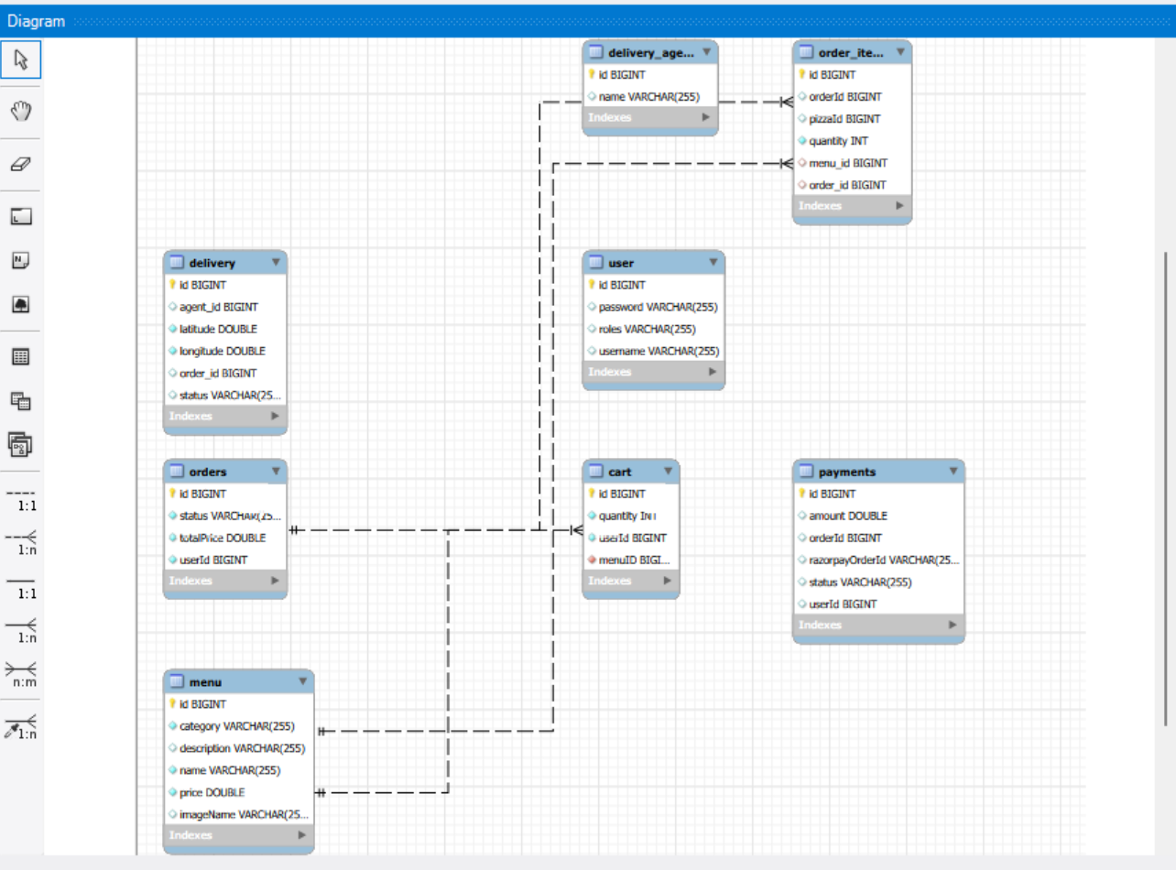

Slide 11
API Modules
Auth APIs
Menu and Cart APIs
Order and Payment APIs
Delivery APIs
Admin Analytics APIs

Slide 12
Customer Flow
Landing page
Menu with images
Pizza details
Cart and checkout invoice
Razorpay payment
Tracking page

Slide 13
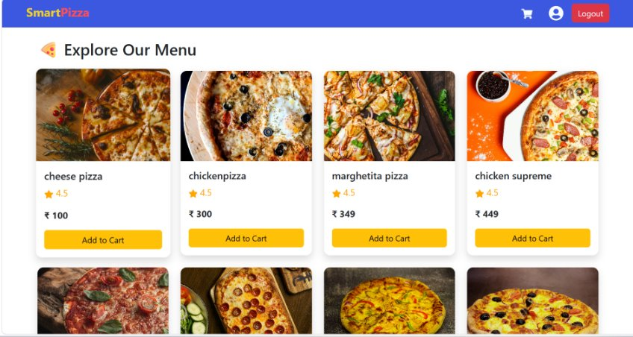

Slide 14
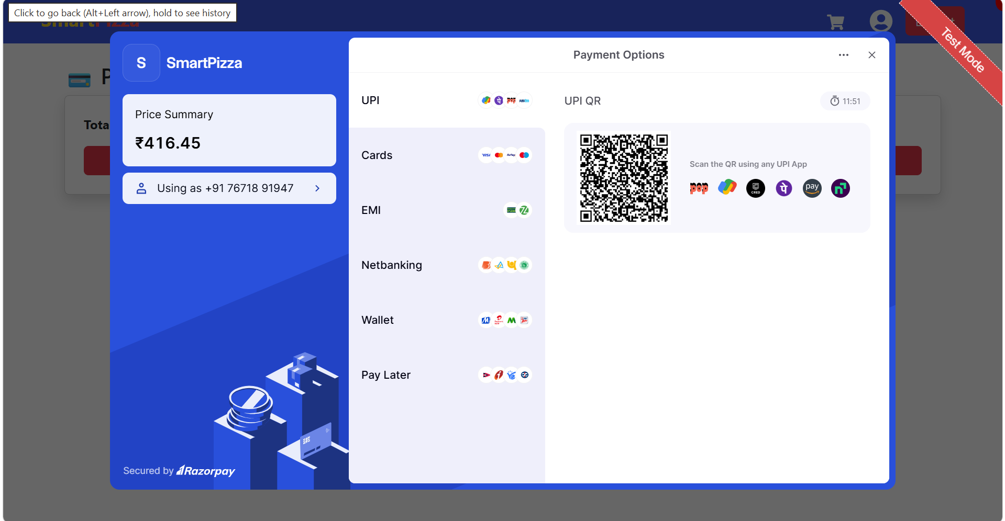

Slide 15
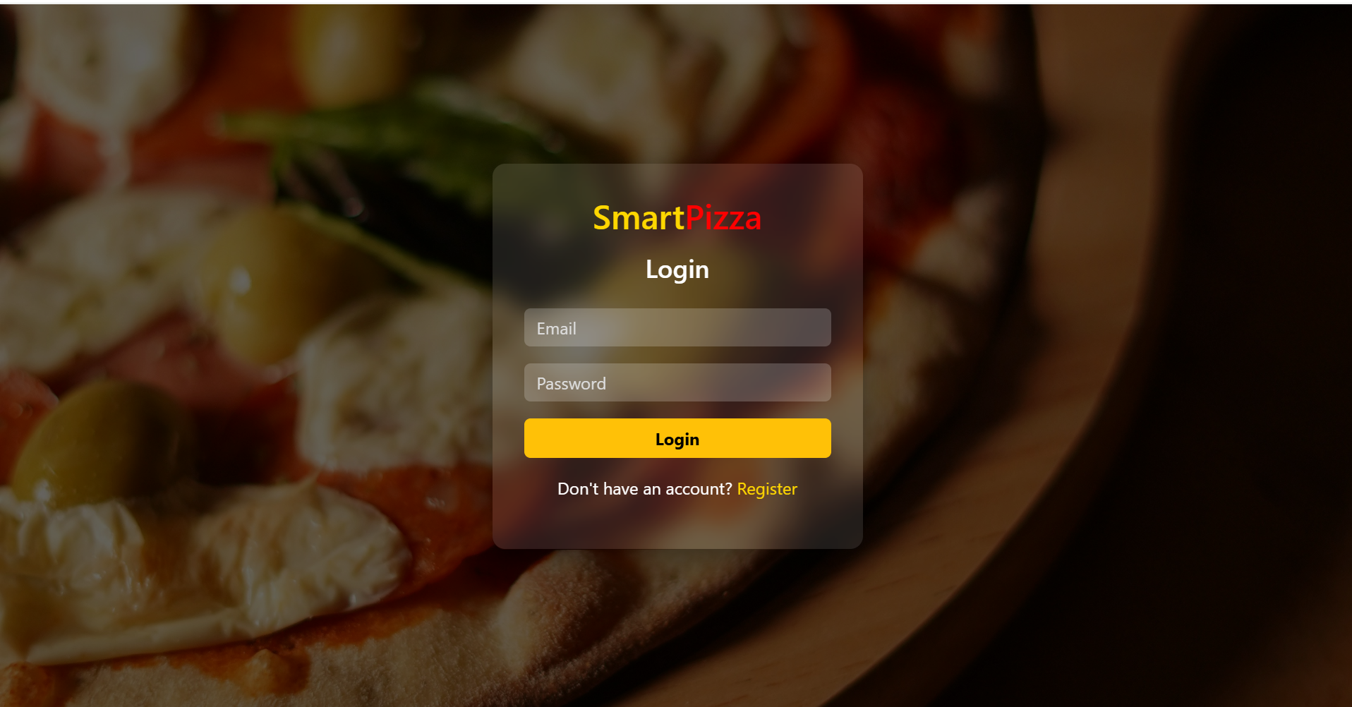
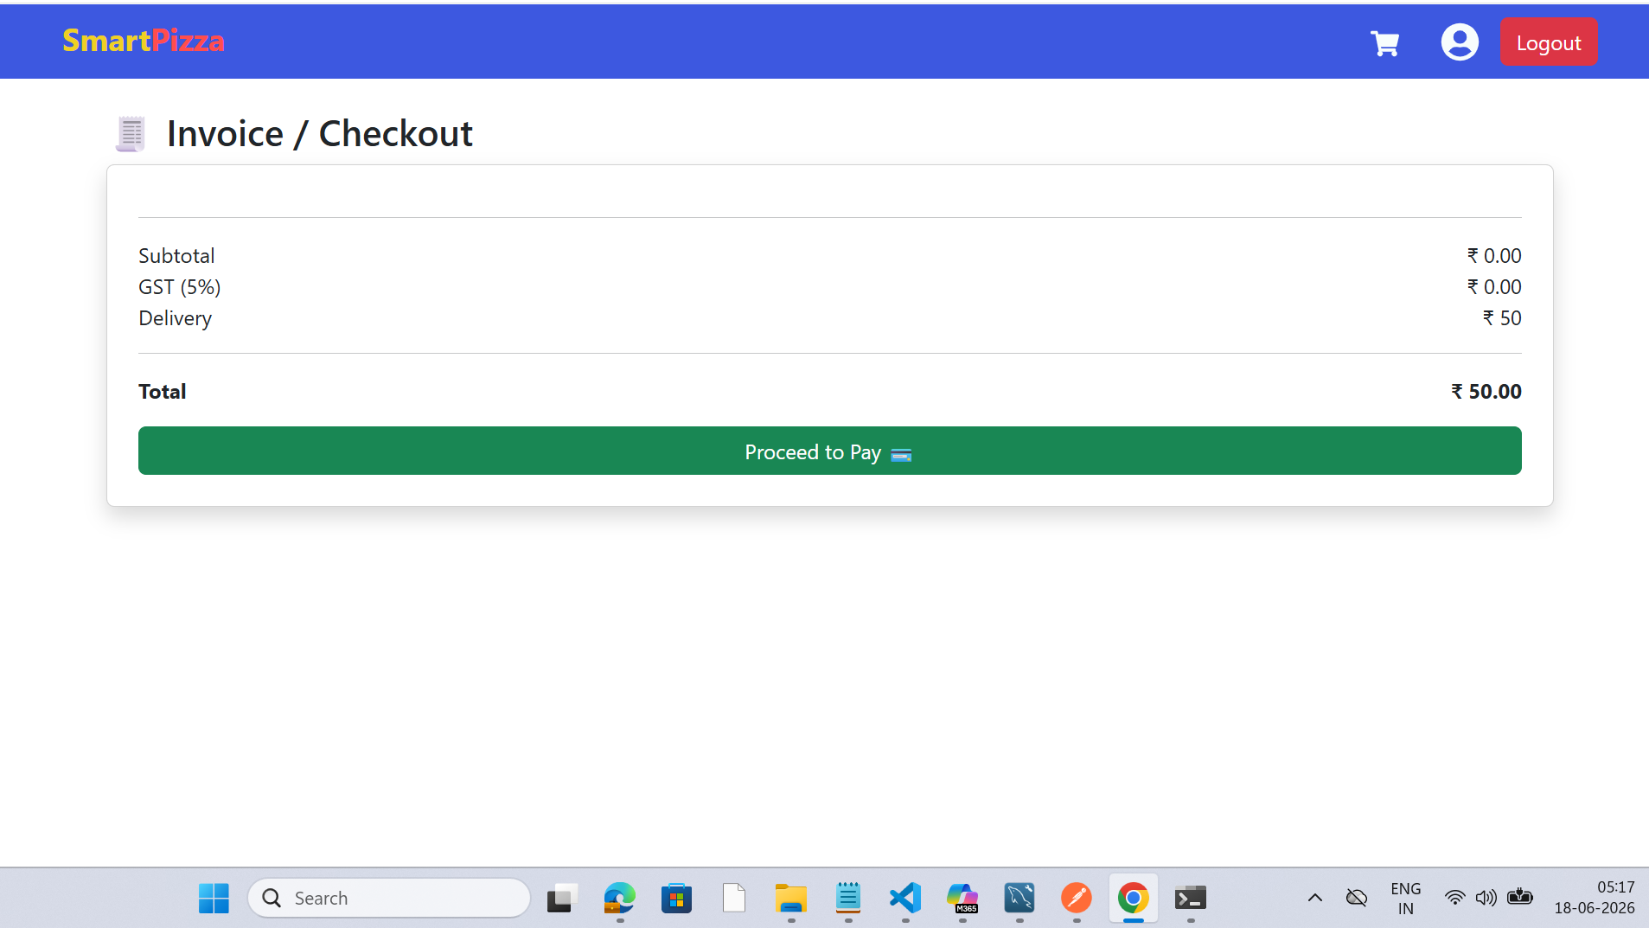

Slide 16
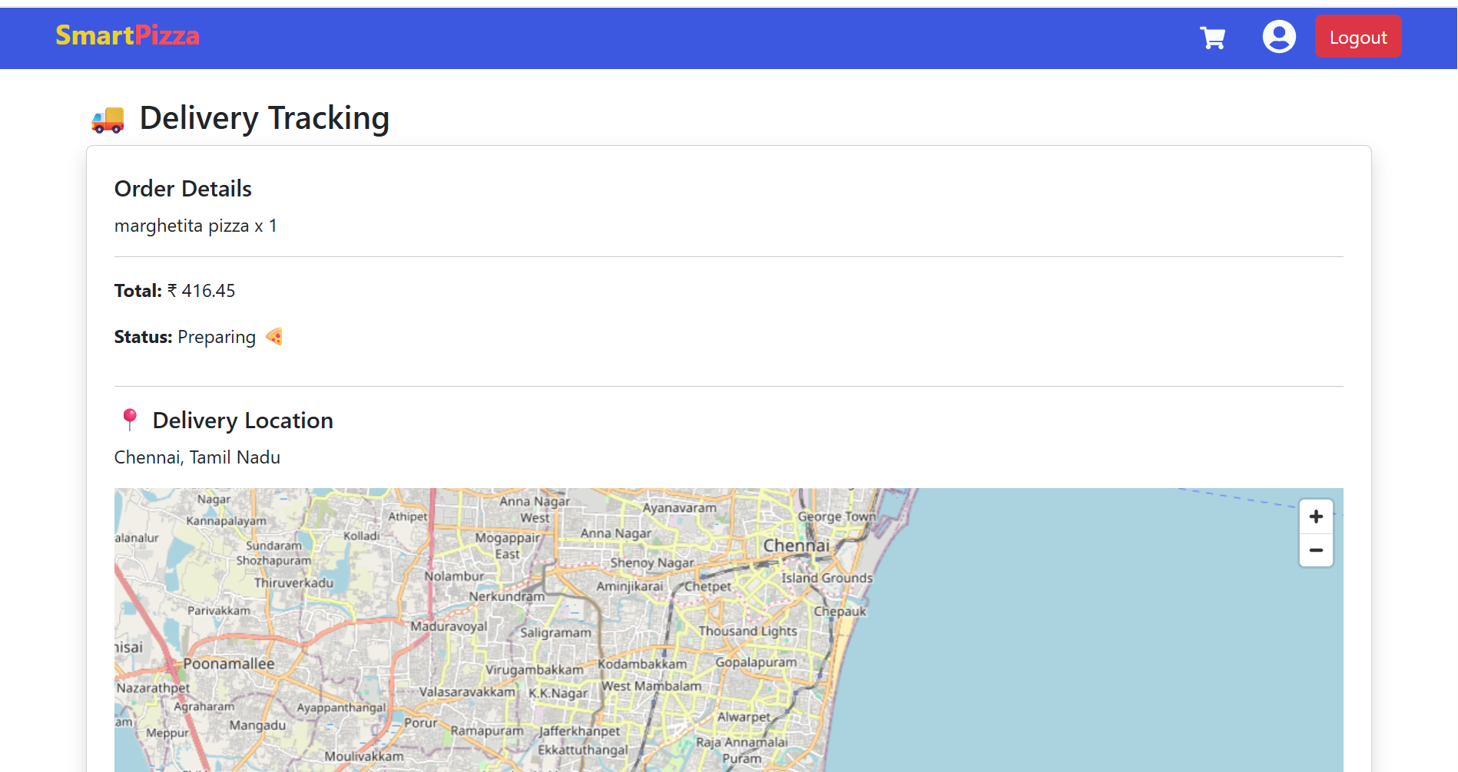
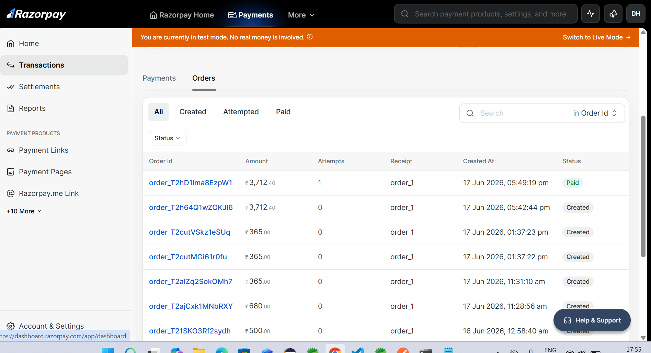

Slide 17
Delivery Flow
Delivery list
Accept delivery
Map tracking
Update location
Mark delivered
History

Slide 18
Admin Dashboard
Revenue analytics
Top-selling pizzas
Delivery performance
Customer trends
Users and orders

Slide 19
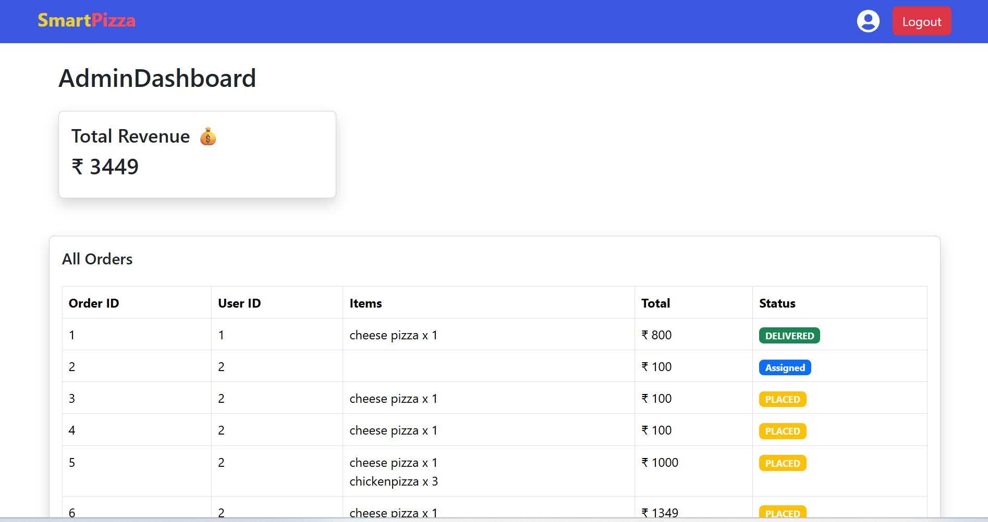
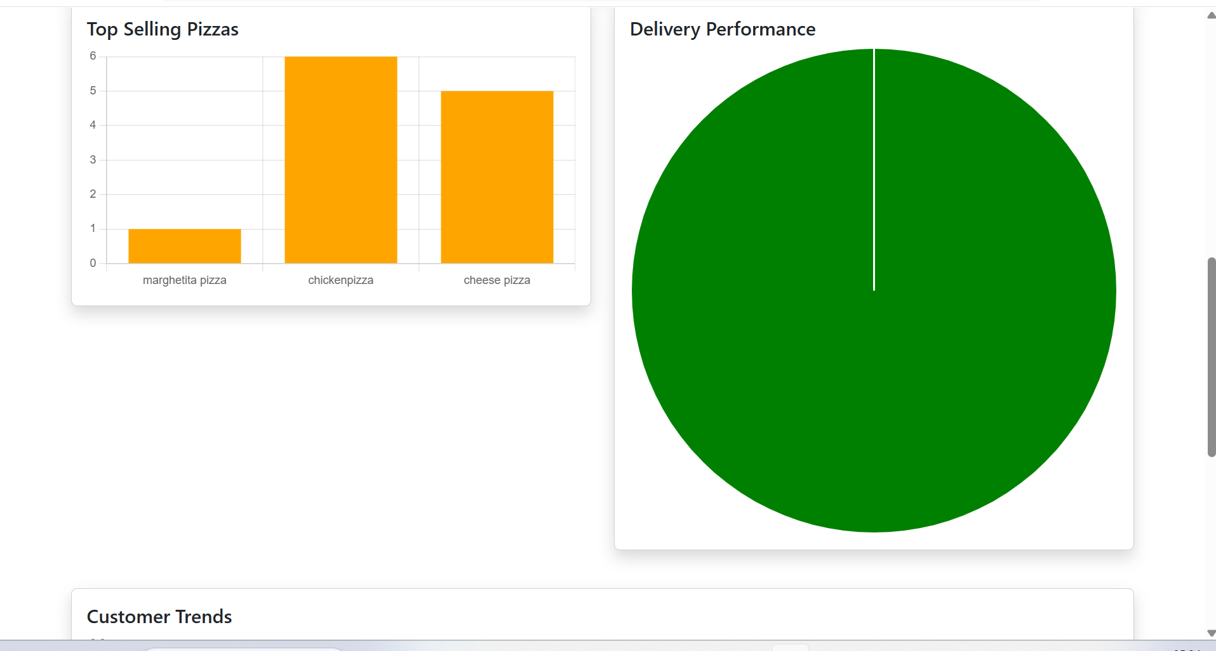

Slide 20
Testing
JUnit and Mockito unit tests
Postman API testing
Frontend route testing
Payment and delivery flow testing

Slide 21
Deployment
Start Eureka
Start Gateway
Start microservices
Start React frontend
Verify service registration and API calls

Slide 22
Conclusion
Project demonstrates complete full-stack architecture
Supports real business flows
Ready for future enhancements like WebSocket tracking and Docker deployment

